Slide 1

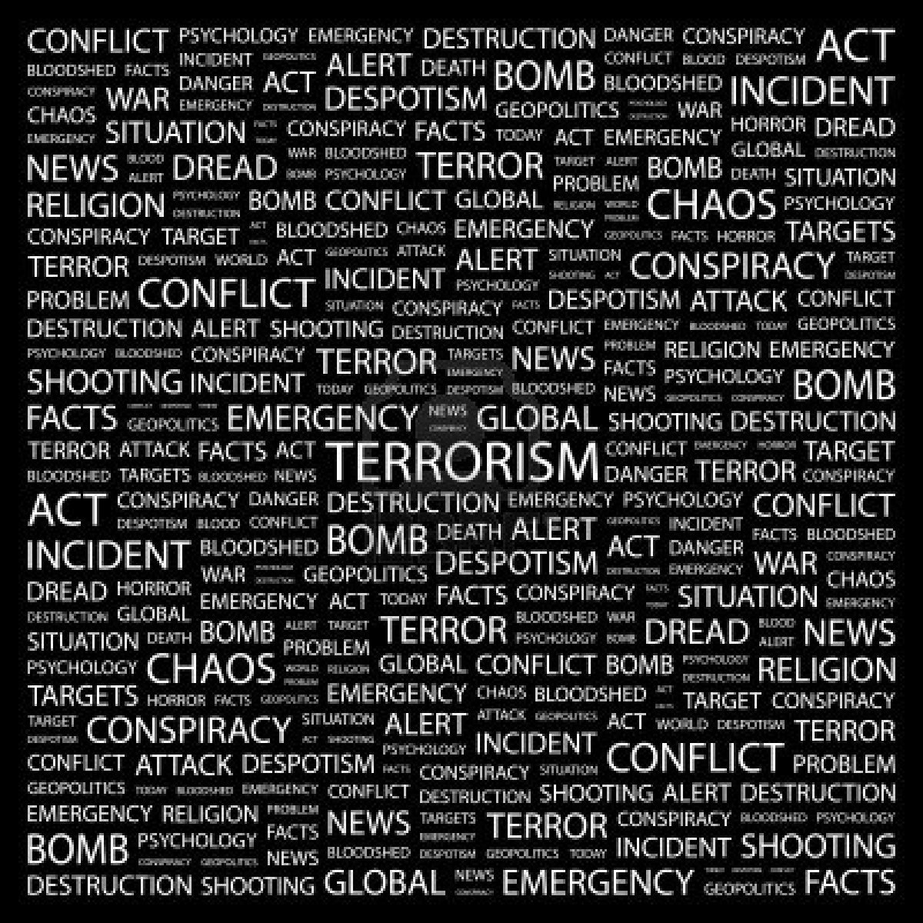
Brady Smiley

Slide 2

What is Terrorism?
By definition, terrorism is the use of violence and intimidation in the pursuit of political aims.

Slide 3

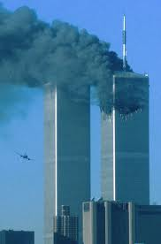


Examples of Terrorism
Ku Klux Klan
Wall Street bombing of 1920
September 11, 2001

Slide 4
How it affects the Middle East
The Middle East is home to many terrorist cells. The most well-known would most likely be al-Qaeda due to their attacks on 9/11. These terrorist organizations are slowly falling apart as we take down their leaders, such as Osama Bin Laden.

Slide 5
What is the UN doing about it?
Terrorism has been of concern to the international community since 1937 when the League of Nations adopted the Convention for the Prevention and Punishment of Terrorism. Subsequently, the United Nations and other international and regional inter-governmental organizations have dealt with terrorism from a legal and political prospective. In September 2006, UN Member States unanimously agreed to coordinate their counter-terrorism efforts by gathering the broad array of UN programmes, offices and agencies of the UN engaged in counterterrorism activities under the UN Global Counter Terrorism Strategy , which provides a common strategic and operational framework to fight terrorism

Slide 6
The Future of Terrorism
Ten years after its iconic attacks on US landmarks, al Qaeda no longer occupies the center stage in global security. The relentless US targeting led to the massive degradation of al Qaeda, the core of the global terrorist movement. This included the decapitation of Osama bin Laden, the al Qaeda founder leader, in Abbotabad in Pakistan on May 2, 2011. The epicentre of the network suffered another blow when his successor Dr. Ayman al Zawahiri’s deputy Attiyah Abd-al-Rahman alias Attiyah Allah was killed in a CIA US drone strike in North Waziristan, Pakistan on August 22, 2011.

Slide 7
Will terrorism issues be resolved?
In the face of threatening terrorism some goals are hoped to be met in the next years. self-radicalized homegrown terrorism will eclipse the threat posed by traditional terrorist groups operating out of failed and fragile states, continuity and likely escalation of threat in Iraq and Afghanistan, expansion and escalation of threat in Yemen and Somalia, and, displacement of the threat from the Maghreb to the Sahel and West Africa.

Slide 8
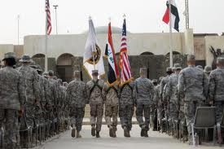
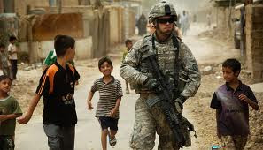
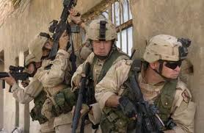



Slide 9
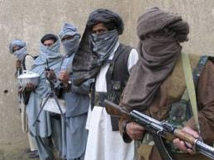

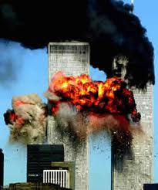
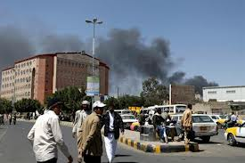
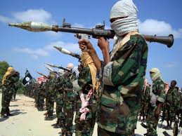
al-Qaeda

Slide 10
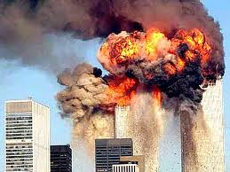
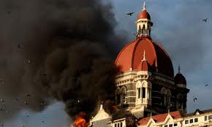
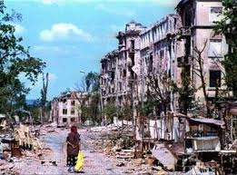
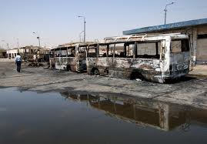
Historic Terrorist Attacks

